Slide 1
Feature embeddings -- deep metric learning
Tag: Shape Recognition Preprocess
Yan MA

Slide 2
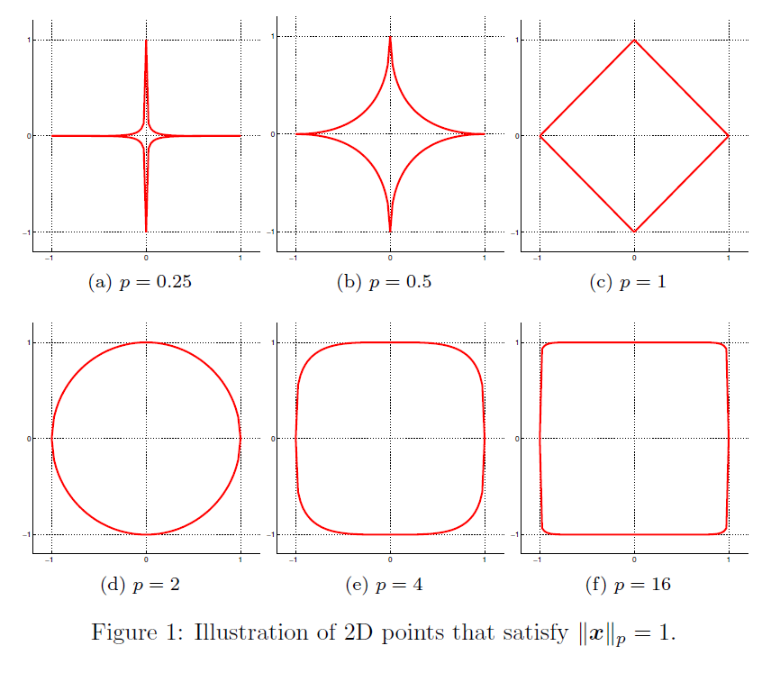
Old-Fashion Method
Kernel Trick
RBF(Gaussian) Kernel
Polynomial Kernel
Characteristic: Mapping feature into a high-dimensional space
Metric Learning
General metric
Lp Distance

Slide 3
Metric Learning
Metric Learning Purpose:
Find embedding space to measure the similarity of image or images.
Mahalanobis Distance Metric Learning

Slide 4
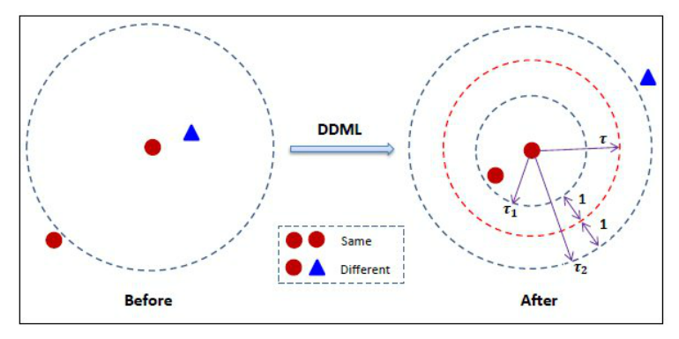
Target: Distances between positive pairs are smaller than those between negative pars

Slide 5
DDML Mathematical Form
Loss function:

Slide 6
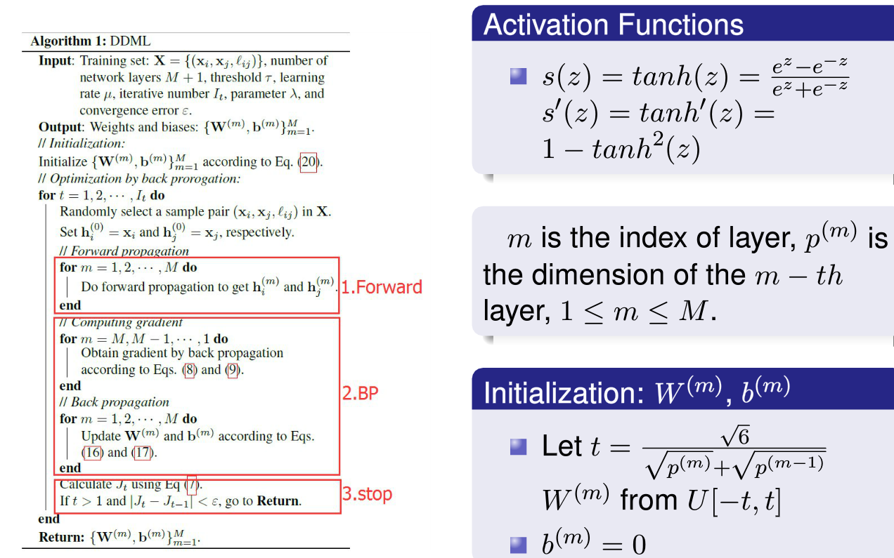

Slide 7
Contrastive embedding
Trained on paired data
Minimizes the distance between a pair of examples with same class label and penalizes the negative pair distances for being smaller than the margin parameter

Slide 8
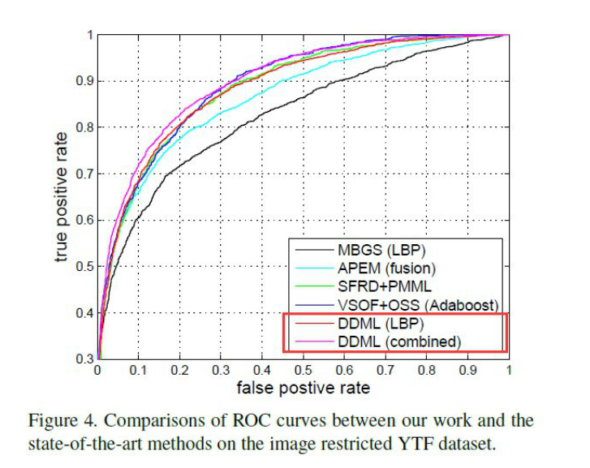
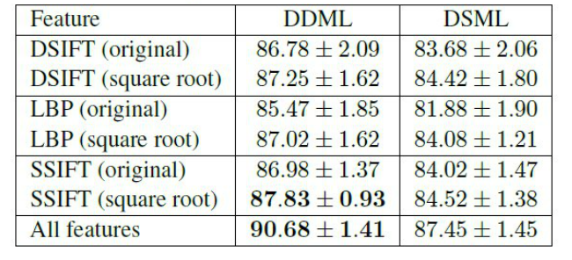
Experimental Results

Slide 9
Triplet embedding
Trained on triplet data
Training process encourages the networks to find an embedding where the distance between anchor and negative is larger than anchor and positive plus margin parameter \alpha
Cost Function

Slide 10

Experiments results
Performance
Metric: average classification rates and the standard deviations.

Slide 11
Lifted Structured Feature Embedding
Maximum the mini-batch and solve the bad local optima problem.
Problems
Non-smooth
Computing the all pairs subgradient requires all requires mining all pairs several times.

Slide 12
Solution
Use smooth function
Given a batch of c-dimensional embedded features the column vector of squared norm of individual batch elements
Distance Matrix

Slide 13
Experiments
Metrics
F1 Score
NMI(Normalized mutual information; cluster)
Recall@K

Slide 14
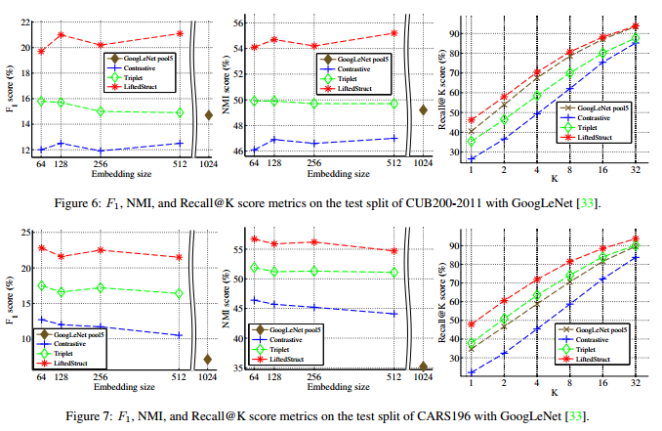
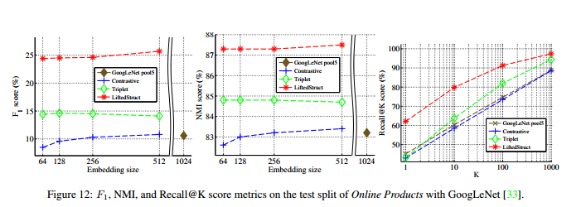

Slide 15
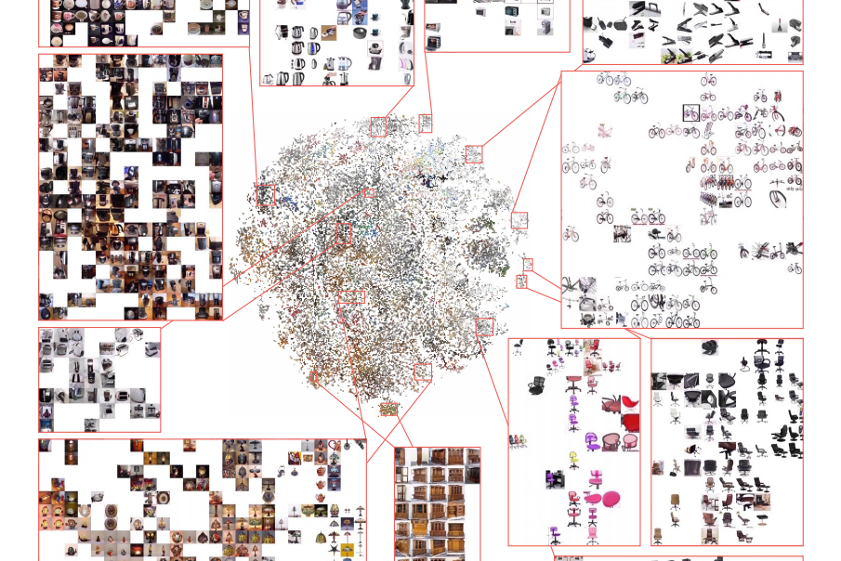

Slide 16
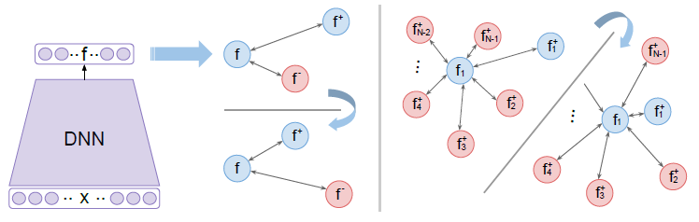
Improved Deep Metric Learning with Multi-class N-pair Loss Objective
Motivation:
Maximum efficiency of negative samples.
Solve the bad local optima problem.
An input example is being compared against negative examples from multiple classes and it should be distinguishable from all of them at the same time.

Slide 17
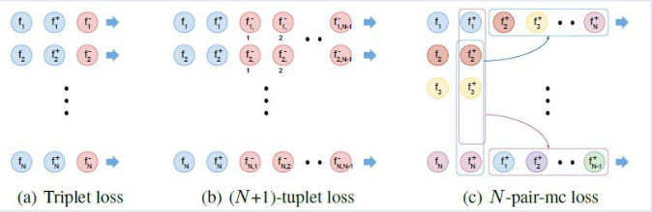
loss
Loss fuction:

Slide 18
Hard negative class mining
REASON: triplet-DDML improve convergence speed or the final discriminative performance.
Evaluate Embedding Vectors: choose randomly a large number of output classes C; for each class, randomly pass a few (one or two) examples to extract their embedding vectors.
Select Negative Classes: select one class randomly from C classes from step1. Next, greedily add a new class violates triplet constraint the most w.r.t. the selected classes till we reach N classes. When a tie appears, we randomly pick one of tied classes.
Finalize N-pair: draw two examples from each selected class from step2.

Slide 19
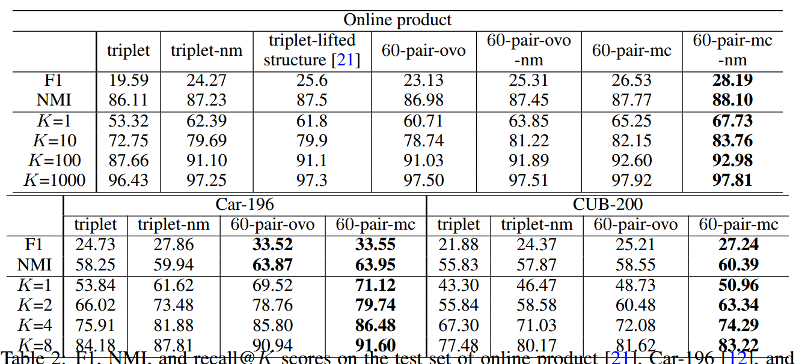
Experiments

Slide 20
Comments
Mapping equation play an important role in distance metric learning method.
Loss function:
Lifted structured Loss function is the best loss function for DDML.
N-pair multi-classes loss function is useful in preparing training data.

Slide 21
Follow-on works
1.Training data:
[Technical question] generate training data.
2.Use simple net to train the DDML model.
3.Connect the task with Faster RCNN tasks.

